Slide 1

RISE OF THE
BOTS
ContosoBot
MSA Phase 2

Slide 2

How can Contoso Improve engagement with its customers?
1. Who goes to the bank anymore?
2. Future of Digital Banking..

Slide 3
About Me..
Name: Angel Dasari
Study: Finance, Information Systems and Statistics
Why MSA?

Slide 4

What does the Bot do? (Insert Images)
Gives customers a chance to look up primary information about the stock by just entering the ticker symbol into their Facebook conversation (Quick Access) Date, Time of the Price, Market Capitalisation, Change in percentage YTD
How does it work? - EXTERNAL API
Used C# to write the code. And used azure to deploy
This leverages the Bot Framework to give customers a conversational platform to find what they’r looking for
(Stock Information)
A personalised service

Slide 5
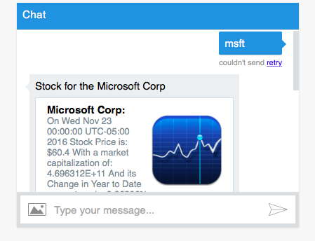
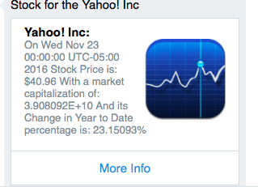
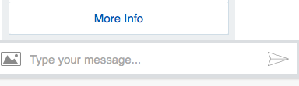
HOW DOES IT WORK?

Slide 6
FEATURES!
1. CARDS (INTERACTIVE WHICH IMPROVES USER EXPERIENCE)
2. LINKS ATTACHED TO THE CARD
3. SOCIAL MEDIA CONNECTION
4. LUIS (DIDN’T WORK AS PLANNED)

Slide 7
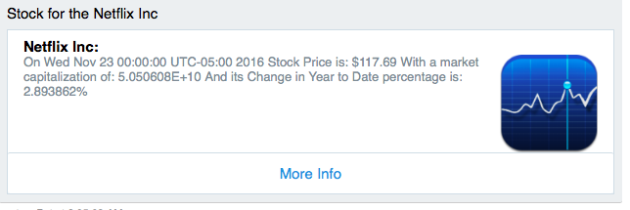
CARDS
FEATURE 1
Quick View
Interactive Medium
Intuitive Use

Slide 8
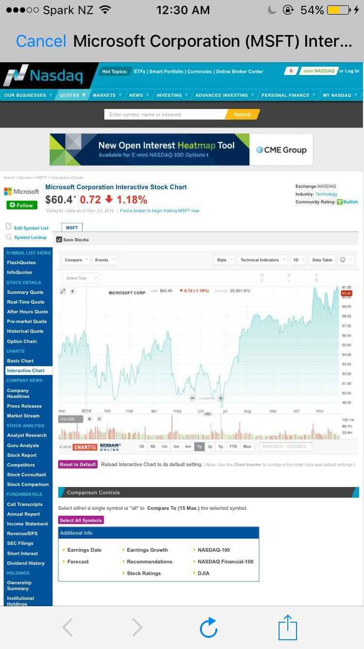
MORE INFO! (EXTERNAL LINK)
FEATURE 2
NASDAQ
Trend View
Clear Understanding

Slide 9
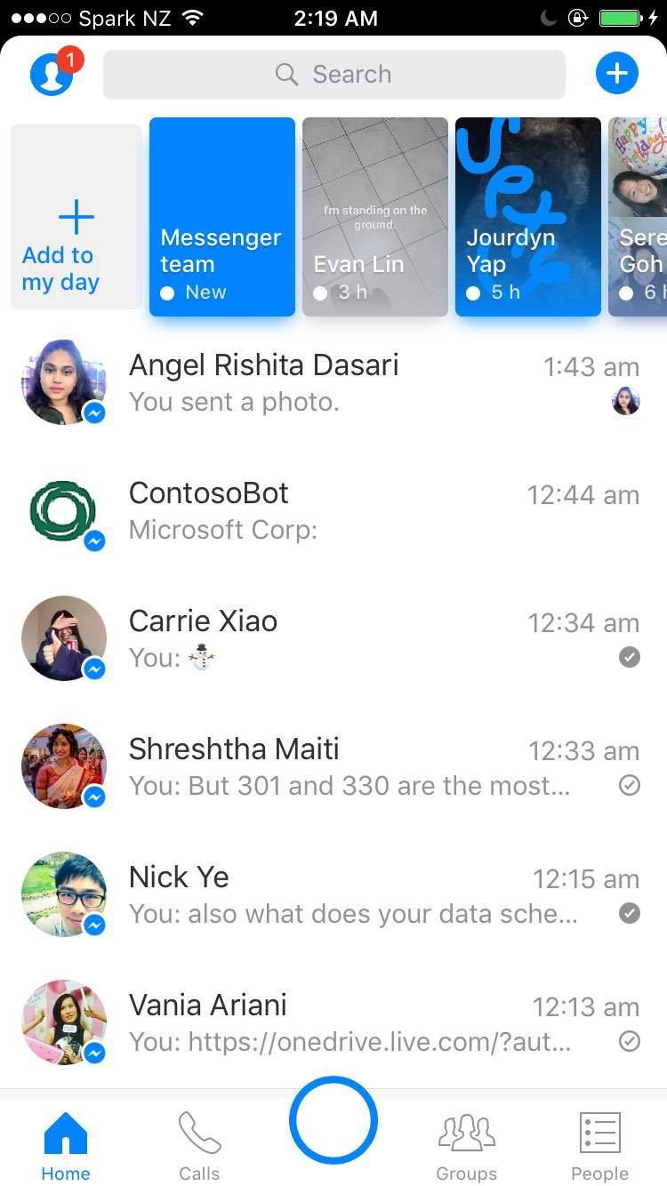
SOCIAL MEDIA CONNECTION
FEATURE 3
Personalised Experience
Easy Access
Transferable Data
(From mobile to your surface to your PC!)

Slide 10
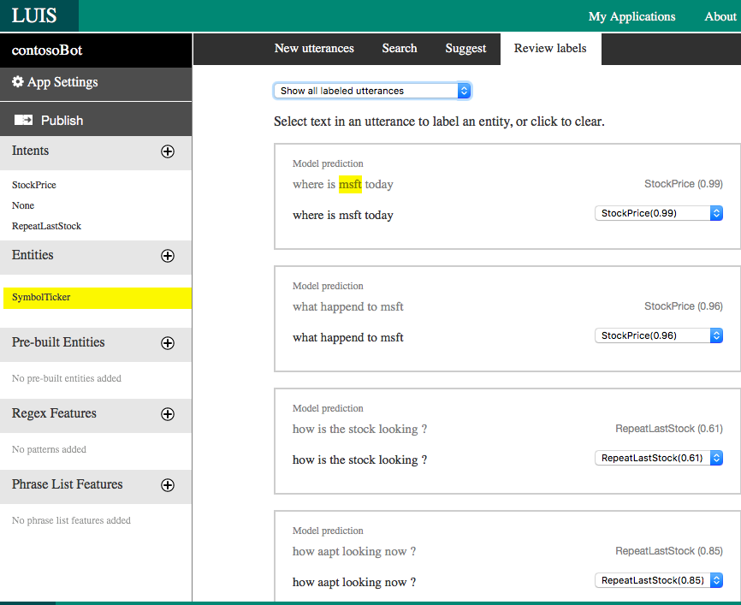
LUIS … :(
FEATURE 4
Natural Language
Brings the conversation to Life
EASE

Slide 11
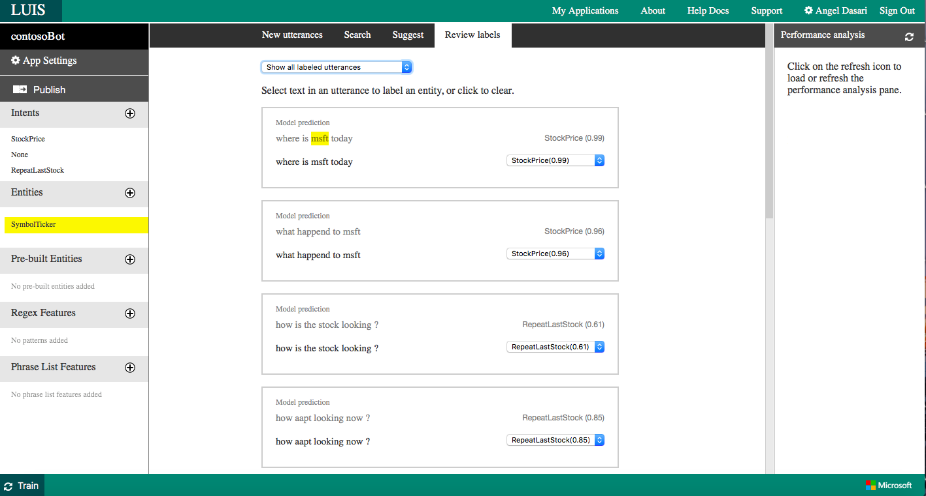
TRAINING LUIS

Slide 12
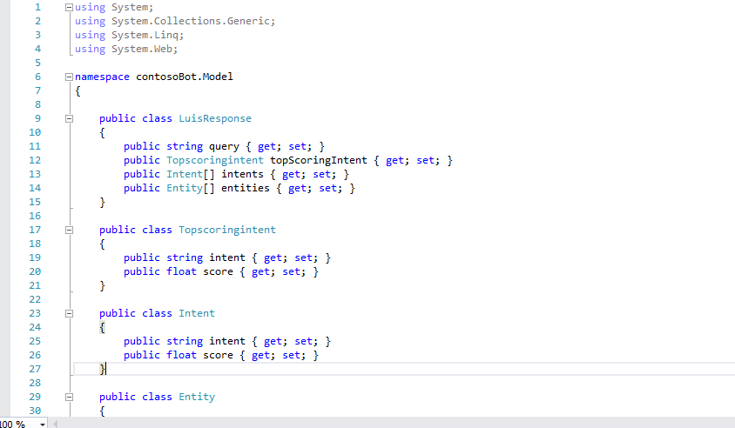
LUIS MODEL

Slide 13
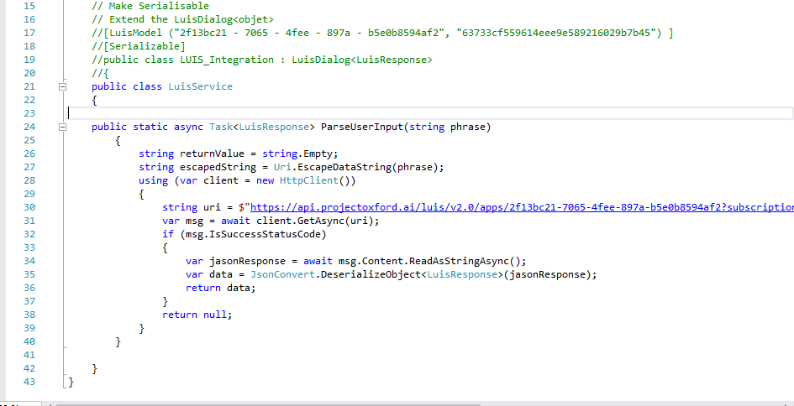
CODE WITH LUIS

Slide 14
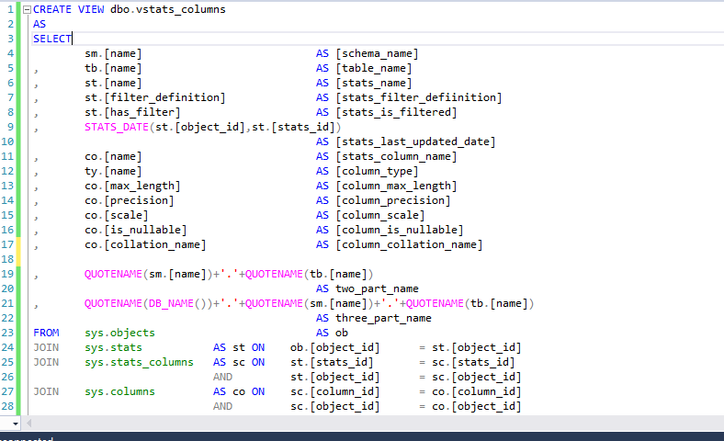
DATA SCHEMA - DUMMY DATA BASE

Slide 15
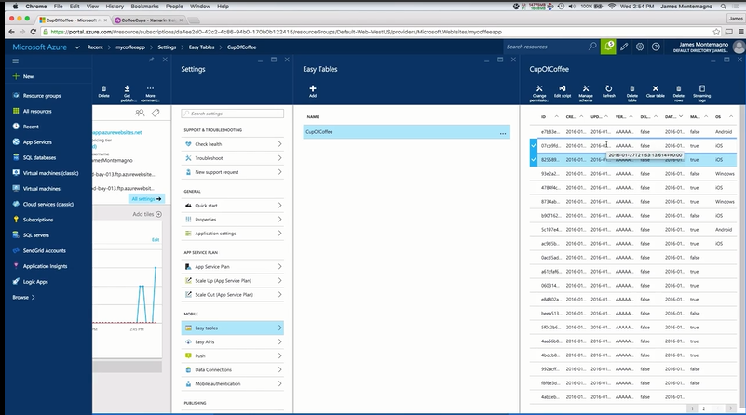
POTENTIAL WITH EASY TABLES

Slide 16
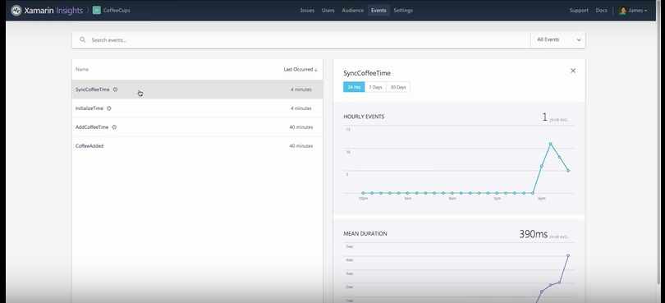
POTENTIAL WITH EASY TABLES

Slide 17
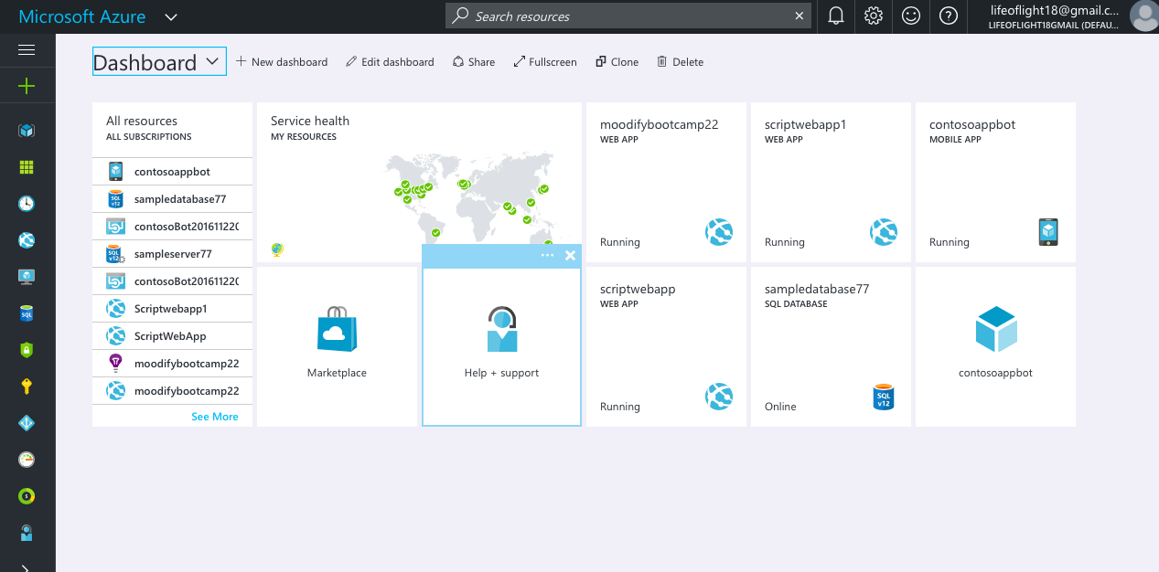
AZURE PORTAL

Slide 18
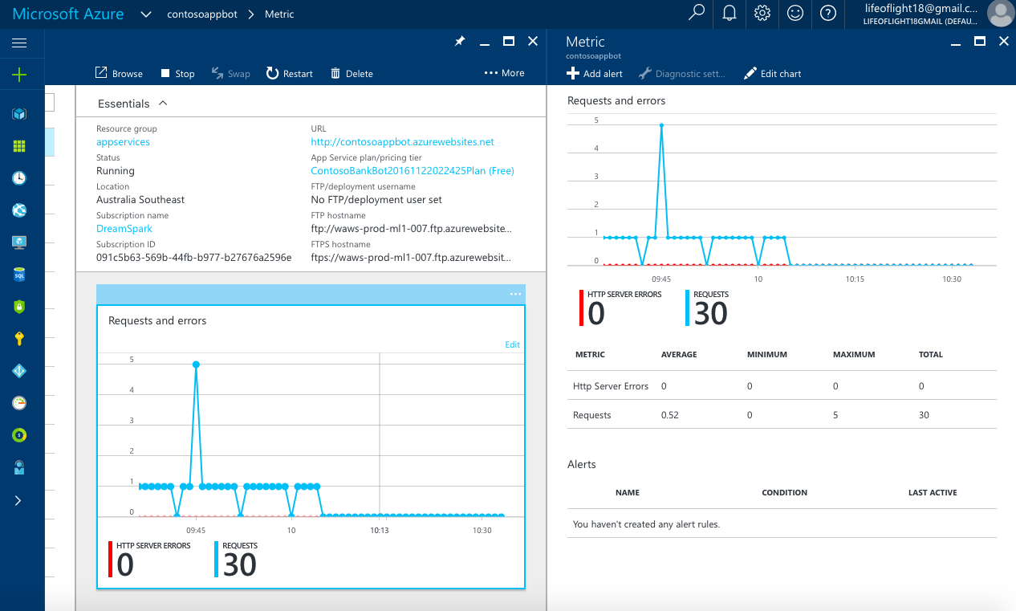
AZURE PORTAL
TEXT

Slide 19
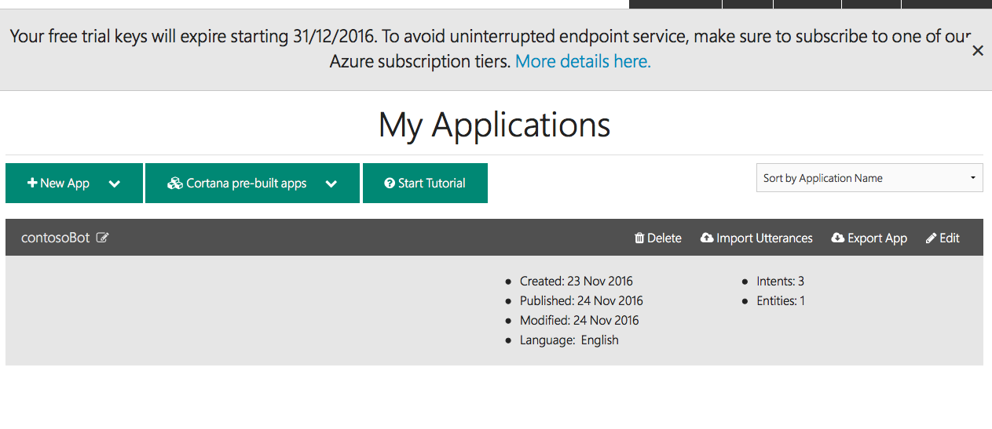
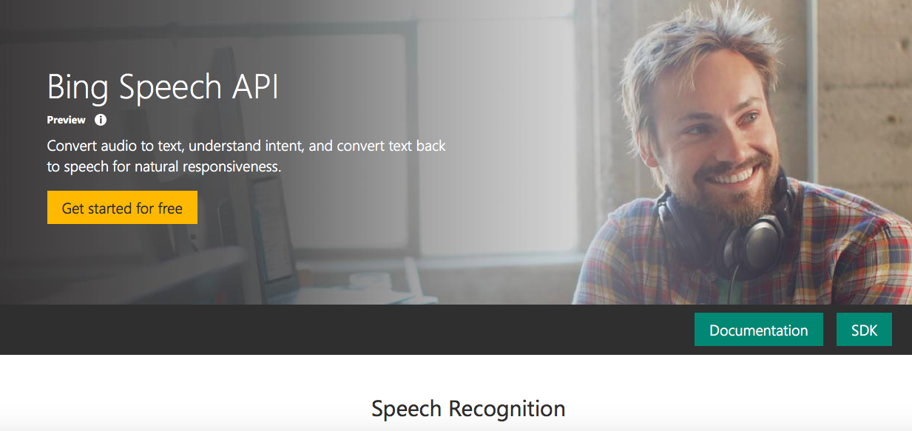
POTENTIAL = LUIS + COGNITIVE SERVICES

Slide 20
THE POSSIBILITIES ARE INFINITE

